Slide 1

Predicting Fuel Consumption and Flight Delays for Low-Cost Airlines

Slide 2
Introduction
What is a low-cost airline (LCA)?
Service quality
Problem statement
Methodology

Slide 3
Data description
Predictive modeling approaches were used on real airline datasets provided by Peach Aviation, an LCA company operating flights among more than 20 airports in Asia.
Three datasets
Flight dataset
Passenger dataset
Reservation dataset

Slide 4
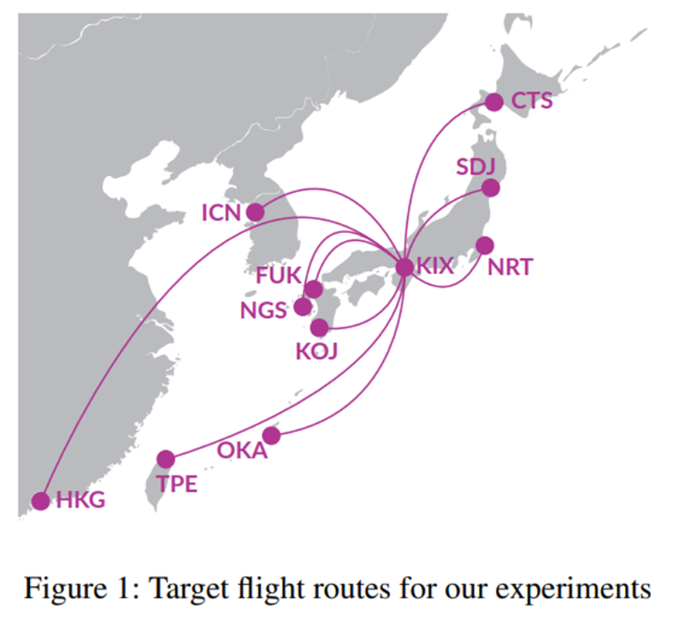
Data description

Slide 5
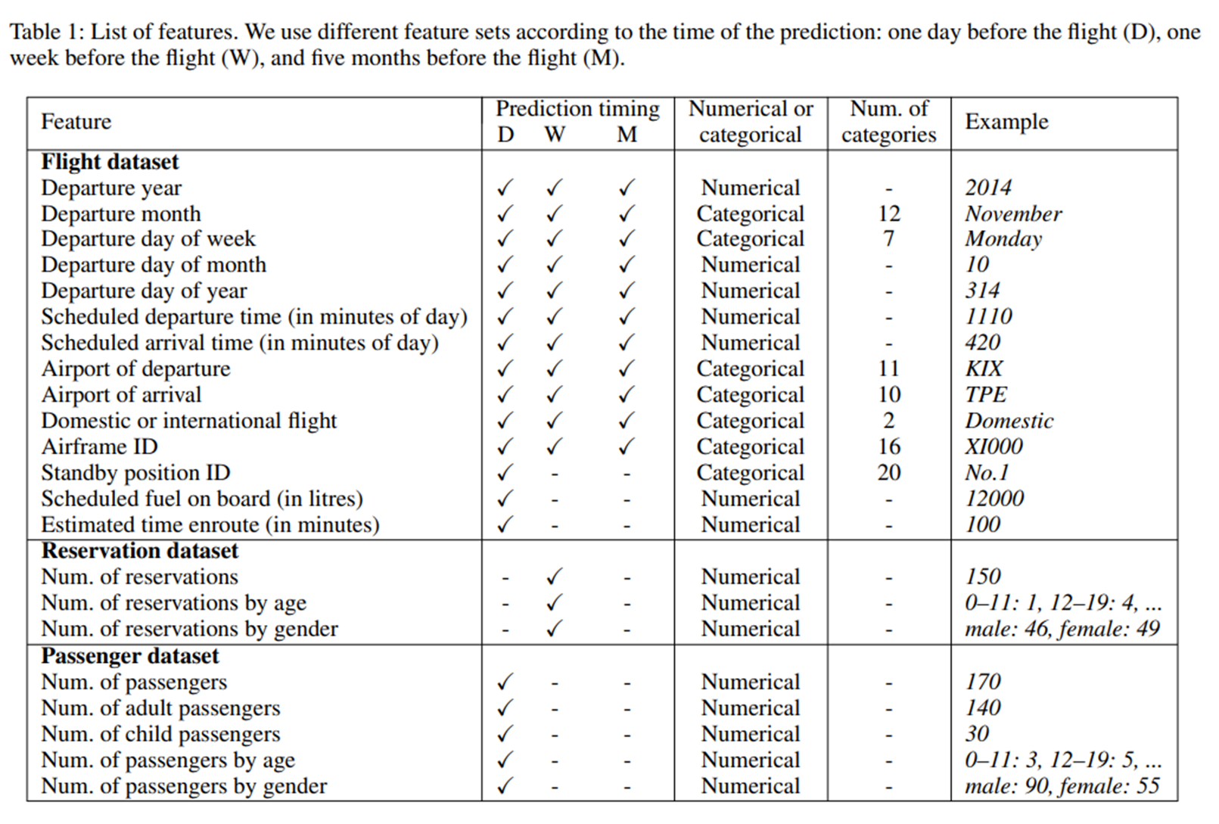
Flight feature representation

Slide 6
Flight feature representation
The number of reservations observed on the day before the departure is almost equivalent to the actual number of passengers
min–max normalization was applied to the features to transform the value of each feature into the range of zero to one

Slide 7
Fuel Consumption Prediction
Predicting the fuel consumption for each flight and for each day
Baseline
Prediction models
Random forests
XGBoost
Deep neural networks
Rectified linear unit was used as the activation function for the hidden layer
Sigmoid function was used as the activation function for the output layer
Keras was used to implement the models

Slide 8
Fuel consumption prediction for each flight
Importance?

Slide 9
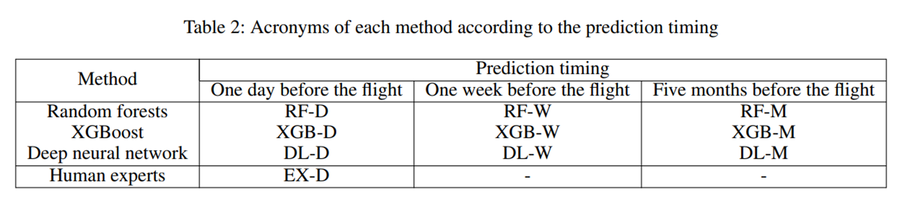
Fuel consumption prediction for each flight

Slide 10
Fuel consumption prediction for each flight
Training and test sets
The authors observed that they could obtain accurate predictions of the number of passengers to some extent by using the information available one week before the flight
The predictions of the number of passengers are given by deep neural networks
The relative RMSE was used as the evaluation measure, which is the root mean squared error normalized by the mean of observed values.
The authors evaluate a fuel underestimation ratio, which is the frequency of the cases where the predicted fuel consumption was lower than 97% of the actual amount of fuel consumption.

Slide 11
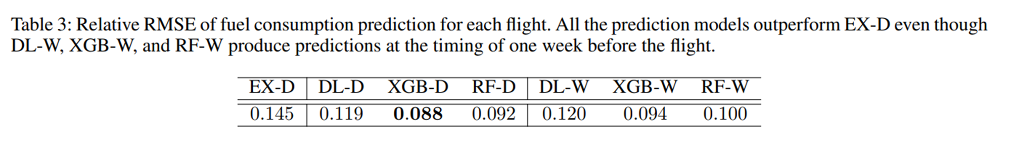
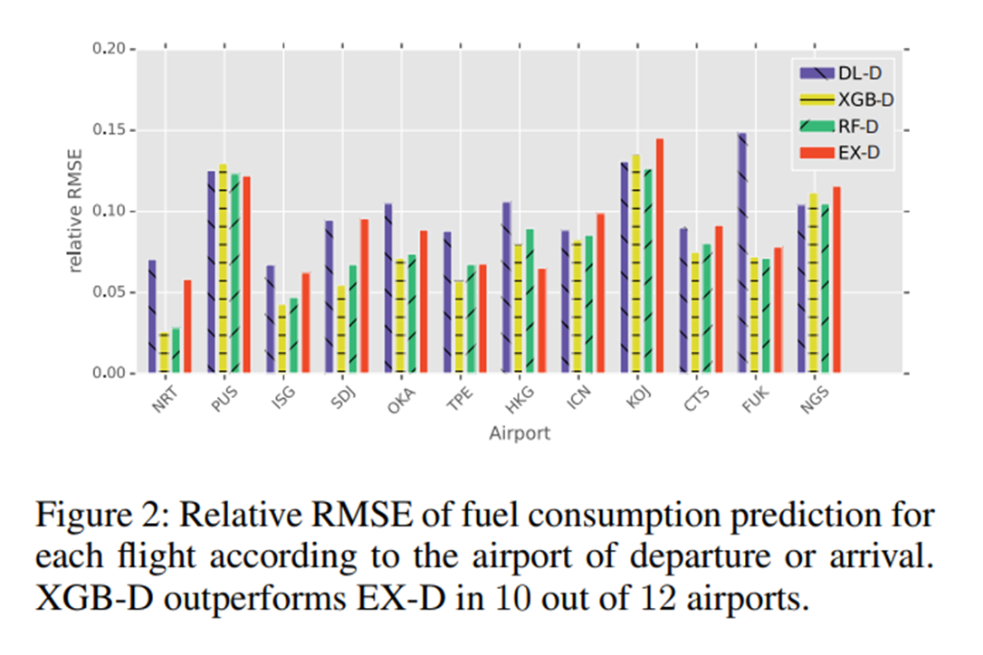
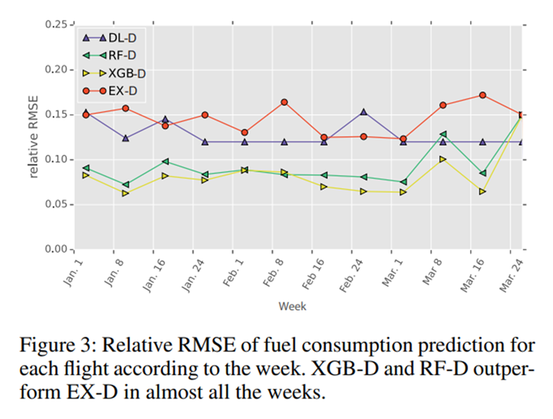
Fuel consumption prediction for each flight

Slide 12
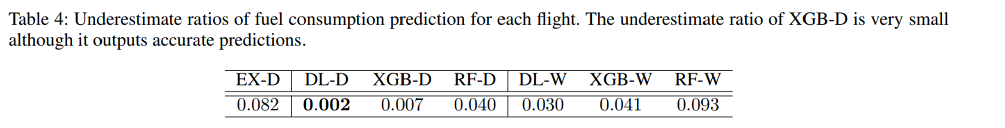
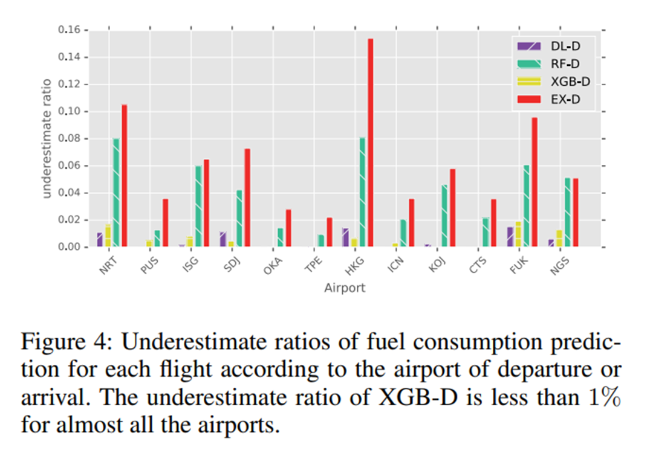
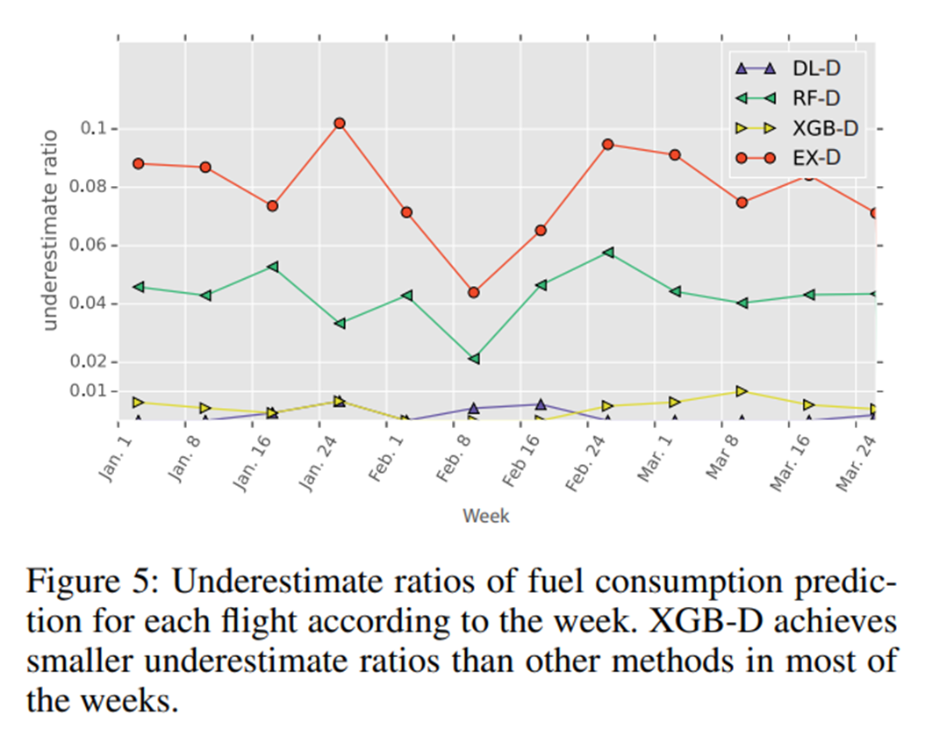
Fuel consumption prediction for each flight

Slide 13
Fuel consumption prediction for each flight
The XGBoost model indicated that “departure day of year”, “cosine of departure day of year”, and “number of passengers” were important features for fuel consumption prediction
Why?
“scheduled departure time” and “scheduled arrival time” were also found to be important features
Why?

Slide 14
Fuel consumption prediction for each Day
Importance?
Training and test datasets are the same ones used to predict fuel consumption for each flight
Instead of using the entire dataset, features are obtained using only the information available five months before the flight

Slide 15
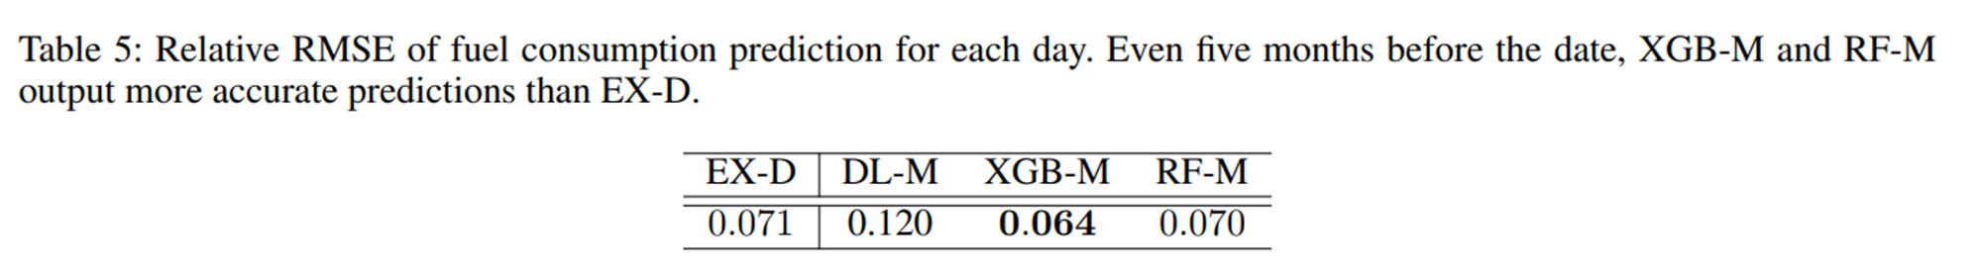
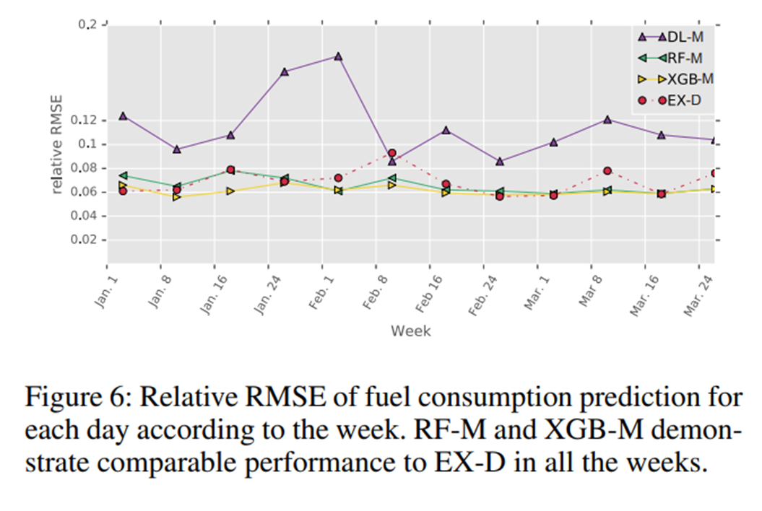
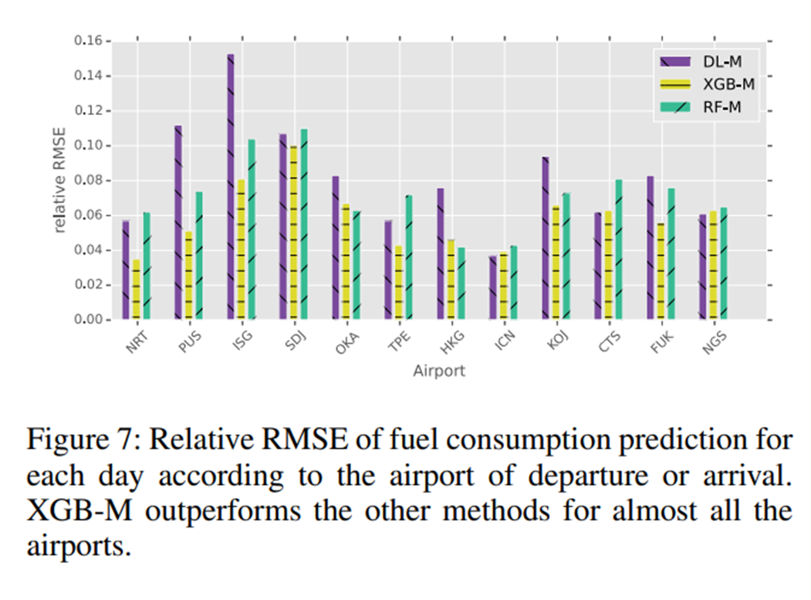
Fuel consumption prediction for each Day

Slide 16
Fuel consumption prediction for each Day
Interpretation of Results

Slide 17
Flight delay Prediction
Importance
The authors describe this problem as a binary classification problem
Why?
The authors define delayed flights as flights whose departure time is 15 minutes behind schedule, which is the same definition provided by the Federal Aviation Administration
The random forests, XGBoost, and deep neural networks are once again used
Settings for the deep neural networks are the same as those used in the fuel consumption prediction problem
Training and test sets are the same as well
The area under an ROC curve is used as an evaluation metric

Slide 18
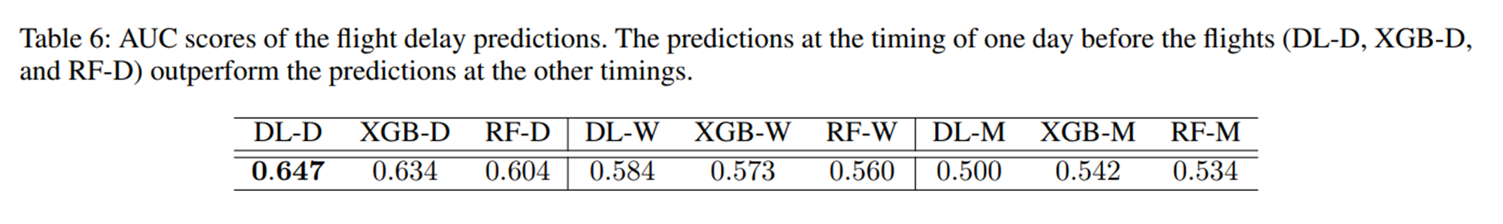
Flight delay Prediction

Slide 19
Flight delay Prediction
Reason for poor performance of other timings?
Models indicate that “fuel on board”, “number of passengers”, and “scheduled departure minute of day” are important features, which are only available one day before the flight

Slide 20
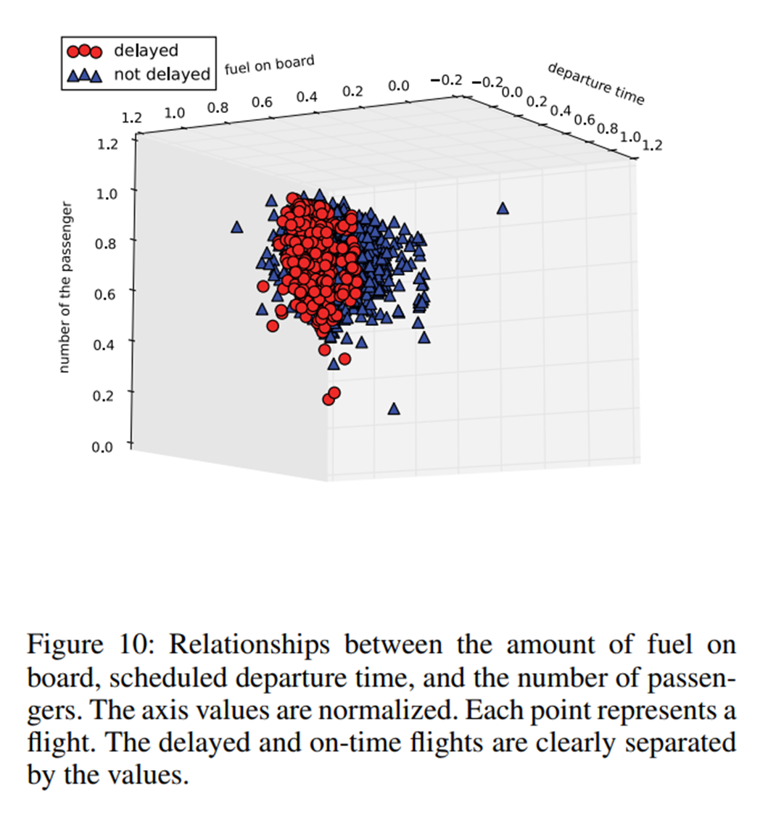
Flight delay Prediction

Slide 21
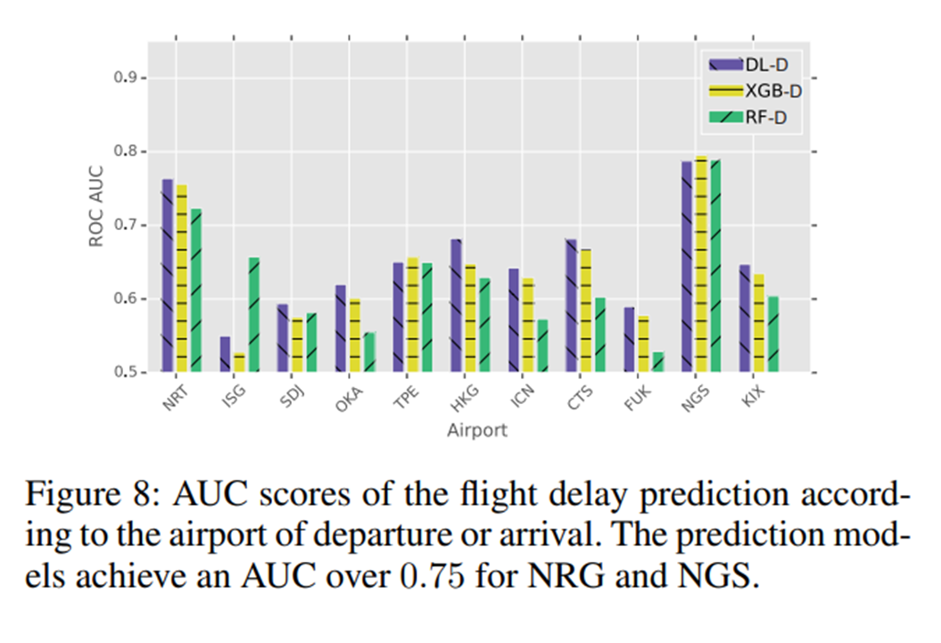
Flight delay Prediction

Slide 22
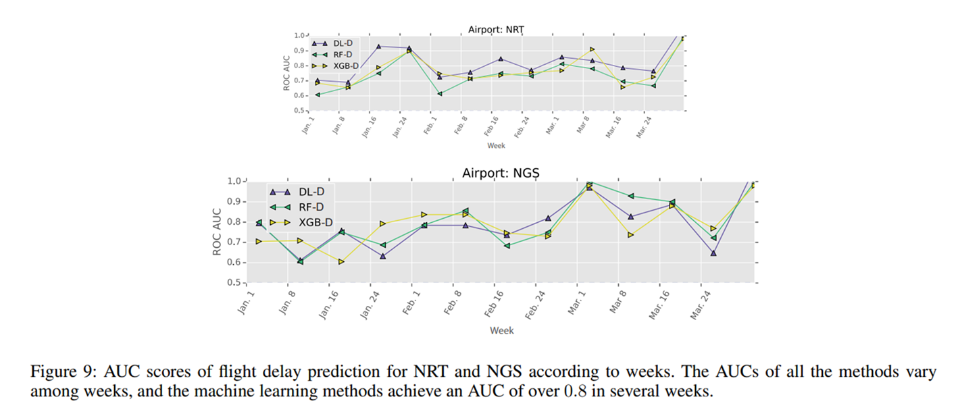
Flight delay Prediction

Slide 23
Flight delay prediction
Interpretation of Results

Slide 24
conclusion
Regression model predicted the amount of fuel consumption for each flight with a relative RMSE of 8.8%. The model performed better than human flight dispatchers and reduced the prediction errors by 39.3%
Binary classifier achieved an AUC of over 0.75 for several routes in the one day before predictions of the flight delays

Slide 25
Future work
The authors believe that additional attributes such as the flight data recorder data and meteorological data would help improve the performance of their models
A study to find a method for recommending seats and in-flight purchases by using individual customer information

Slide 26
References
Horiguchi, Yuji, et al. “Predicting Fuel Consumption and Flight Delays for Low-Cost Airlines.” Proceedings of the Twenty-Ninth AAAI Conference on Innovative Applications, Association for the Advancement of Artificial Intelligence, 2017, pp. 4686–4693.

Slide 27
Questions?

